Slide 1





IOT FORENSIC TOOLS & TECHNIQUES
Guided by: Vikash Rai Sir
Present By: Dhaval V Patel
M.Sc. Cyber Security Sem 3
Enroll. No.: 03220300002034
Subject: IoT Security and Forensics

Slide 2

Agenda
Introduction
IoT Forensic Layers
Forensic Tools & Techniques
Challenges
Future Trends
Conclusion
References

Slide 3

Introduction
What is IoT?
The Internet of Things (IoT) refers to the network of physical devices embedded with sensors, software, and other technologies that connect and exchange data with other devices and systems over the internet.
Example: smart homes, wearable devices, industrial sensors, etc.
Why is IoT forensics important?
Growing number of connected devices
Potential security risks: data breaches, malware attacks, etc.
Need to collect and analyze evidence from IoT devices for investigations
Challenges: device heterogeneity, limited memory, lack of standardized methods
Emerging field with significant research and development activity

Slide 4
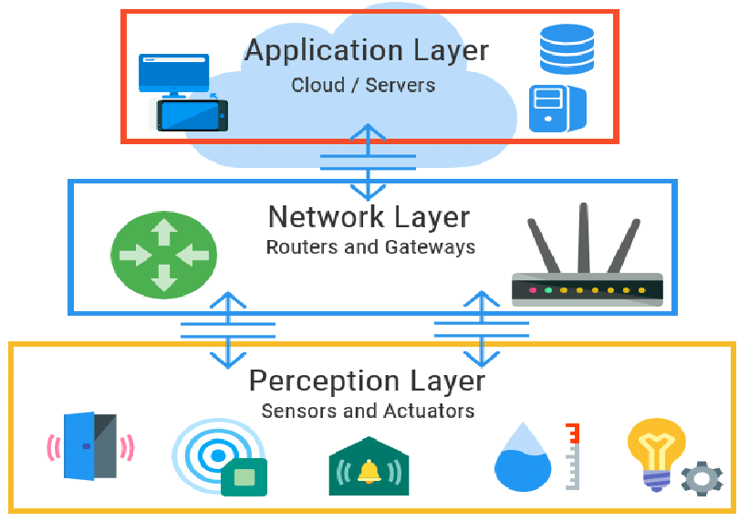
IoT Forensic Layers

Slide 5
IoT Forensic Layers
DEVICE LAYER / PERCEPTOIN LAYER | Acquiring data directly from the device's memory (flash, RAM, etc)
NETWORK LAYER | Analyzing network traffic associated with the device
APPLICATON LAYER | Examining Applications running on the device and their interactions with external services
CLOUD LAYER | Examining data stored in cloud platforms used by the device

Slide 6
IoT Forensic Tools & Techniques
DEVICE LAYER / PERCEPTOIN LAYER | Physical extraction tools (e.g., JTAG, chip-off) Logical acquisition tools (e.g., FTK Imager, Oxygen Forensic Suite) Memory analysis tools (e.g., Volatility, Rekall) Firmware analysis tools (e.g., Binwalk, IDA Pro)
NETWORK LAYER | Packet capture tools (e.g., Wireshark, tcpdump) Network traffic analysis tools (e.g., Bro, ELK Stack)
APPLICATON LAYER | Mobile Forensic Tools Reverse Engineering Tools Data carvig Tools
CLOUD LAYER | Cloud forensic tools (e.g., AWS CloudTrail, GCP Cloud Audit Logging) Cloud data analysis tools (e.g., Google BigQuery, Amazon Athena)

Slide 7
IoT Forensic Tools & Techniques
Layer | Tools | Description | Evidence
Device | JTAG, Chip-off | Physical extraction of data from device memory | Firmware, logs, application data, cryptographic keys
Device | FTK Imager, Oxygen Forensic Suite | Logical acquisition of device storage | Firmware, logs, application data, user data
Device | Volatility, Rekall | Memory analysis | Running processes, loaded modules, network connections, file system activity
Device | Binwalk, IDA Pro | Firmware analysis | Vulnerabilities, backdoors, hidden functionality
Network | Wireshark, tcpdump | Capture network traffic | Network packets, communication logs, protocols used, source/destination IPs, port numbers, data payloads
Network | Bro, ELK Stack | Network traffic analysis | Anomalies, indicators of compromise, intrusion attempts, data exfiltration

Slide 8
IoT Forensic Tools & Techniques
Layer | Tools | Description | Evidence
Application Layer | Fiddler, Charles Proxy | Capture HTTP/HTTPS traffic | HTTP request/response headers, cookies, session IDs, API calls, user activity
Application Layer | Burp Suite, MobiSec | Application analysis | Vulnerabilities, malware, data leaks
Application Layer | App Annie | Mobile application usage data | App installs/uninstalls, usage time, demographics, device information, in-app purchases
Cloud Layer | AWS CloudTrail, GCP Cloud Audit Logging | Cloud resource activity logs | User activity, configuration changes, resource creation/deletion
Cloud Layer | Google BigQuery, Amazon Athena | Cloud data analysis | Logs, metrics, events, sensor data

Slide 9
Challenges in IoT Forensic
Device Heterogeneity:
Wide variety of devices with different architectures, operating systems, and security features.
Limited standardization in device design and data formats.
Difficulty in developing universal forensic tools and techniques.
Limited Memory and Processing Power:
Many IoT devices have limited resources, making it challenging to run forensic tools directly on the device.
Volatility of data stored in memory requires quick acquisition.
Lack of Standardized Forensic Methods:
No established best practices or methodologies for IoT forensics.
Difficulty in interpreting evidence collected from different devices.
Lack of training and expertise in IoT forensics among investigators.
Encryption and Secure Boot:
Increasing use of encryption on devices and in data storage.
Difficulty in accessing and decrypting data without compromising the device's integrity.
Secure boot features may limit access to critical forensic data.

Slide 10
Challenges in IoT Forensic
Network Complexity:
Devices may communicate over various protocols and networks, making it difficult to capture and analyze all relevant traffic.
Identifying malicious activity in complex network environments can be challenging.
Data Privacy Concerns:
Need to balance forensic investigation with data privacy regulations.
Anonymization and pseudonymization of data may be necessary.
Resource Constraints:
Limited availability of trained personnel and specialized equipment for IoT forensics.
Cost of acquiring and maintaining forensic tools and resources can be high.
Emerging Technologies:
New technologies like blockchain and artificial intelligence are creating new challenges for IoT forensics.
Need for continuous research and development to keep pace with technological advancements.
Legal and Regulatory Landscape:
Lack of clear legal frameworks for IoT forensics in many jurisdictions.
Uncertainty regarding data ownership, chain of custody, and admissibility of evidence.

Slide 11
Future Trends of IoT Forensics
1. Specialized Tools and Techniques:
Development of specialized tools and techniques for specific types of IoT devices and platforms.
Integration of AI and machine learning for automated evidence analysis and anomaly detection.
Cloud-based solutions for storing, analyzing, and managing large volumes of IoT forensic data.
2. Standardization and Best Practices:
Development of standardized methodologies and best practices for IoT forensics investigations.
Collaboration between industry, academia, and law enforcement to develop guidelines and standards.
Creation of training programs and certifications for IoT forensic professionals.
3. Addressing Encryption and Secure Boot:
Development of new methods for bypassing encryption and secure boot mechanisms to access critical forensic data.
Research into cryptographic vulnerabilities and exploit techniques specific to IoT devices.
Adoption of secure hardware encryption modules and key management solutions to improve data security without hindering forensics.

Slide 12
Future Trends of IoT Forensics
4. Network Traffic Analysis and Attribution:
Advanced network traffic analysis tools with enhanced capabilities for identifying malicious activity and attributing attacks to specific devices.
Integration of network traffic analysis with other forensic tools to provide a holistic view of an incident.
Development of techniques for analyzing encrypted network traffic and identifying hidden communication channels.
5. Blockchain and Data Provenance:
Utilizing blockchain technology for secure storage and tamper-proof recording of forensic data.
Leveraging blockchain to track the provenance of data and ensure its integrity throughout the investigation process.
Research into the application of blockchain-based solutions for secure evidence sharing and collaboration between investigators.
6. Legal and Regulatory Framework:
Development of clear legal frameworks for IoT forensics investigations and evidence admissibility.
Addressing data privacy concerns and ensuring compliance with relevant regulations.
International collaboration to establish harmonized legal frameworks for global investigations involving IoT devices.

Slide 13
Future Trends of IoT Forensics
7. Collaboration and Open Source Development:
Increased collaboration between researchers, industry players, and law enforcement agencies.
Development of open-source tools and resources to improve accessibility and affordability of IoT forensics solutions.
Sharing knowledge and best practices through open-source communities and conferences.
8. Focus on Automation and Efficiency:
Development of automated tools and workflows for streamlining the forensic process.
Integration of AI and machine learning for faster and more efficient analysis of large datasets.
Reducing the need for manual intervention and human error in the forensic process.

Slide 14
Conclusion
IoT forensics is a rapidly evolving field with significant challenges and opportunities. By understanding the different layers of the IoT ecosystem and the tools and techniques available, investigators can gather critical evidence for cybersecurity investigations.
Addressing the challenges, embracing future trends, and continuously developing new technologies will ensure that IoT forensics remains effective in protecting the security and integrity of the connected world.
As the number of connected devices continues to grow, the importance of IoT forensics will only increase. By investing in research and development, promoting collaboration, and establishing standardized practices, we can ensure that this critical field has the tools and resources needed to address the evolving threats and challenges of the future.
Key takeaways:
IoT forensics plays a crucial role in investigating incidents related to connected devices.
Diverse tools and techniques are available for different layers of the IoT ecosystem.
Challenges exist due to device heterogeneity, limited resources, lack of standardization, and emerging technologies.
Future trends focus on specialized tools, AI integration, standardization, secure data access, network analysis, blockchain, legal frameworks, collaboration, automation, user education, and ongoing research.

Slide 15
References
A Review on the Internet of Things (IoT) Forensics: https://www.pilgrimsway.com/book/9783030604271
Internet of Things Forensics: A Review: https://www.sciencedirect.com/science/article/pii/S2542660520300536
Understanding Digital Forensics: Process, Techniques, and Tools: https://www.bluevoyant.com/services/digital-forensics
Digital Forensic Tools: https://www.sans.org/digital-forensics-incident-response/
Open-Source IoT Forensics Tools: https://github.com/danieldurnea/FBI-tools
IoT Security Foundation: https://iotsecurityfoundation.org/
SANS Institute Reading Room: https://www.sans.org/infosecFAQ/

